Slide 1

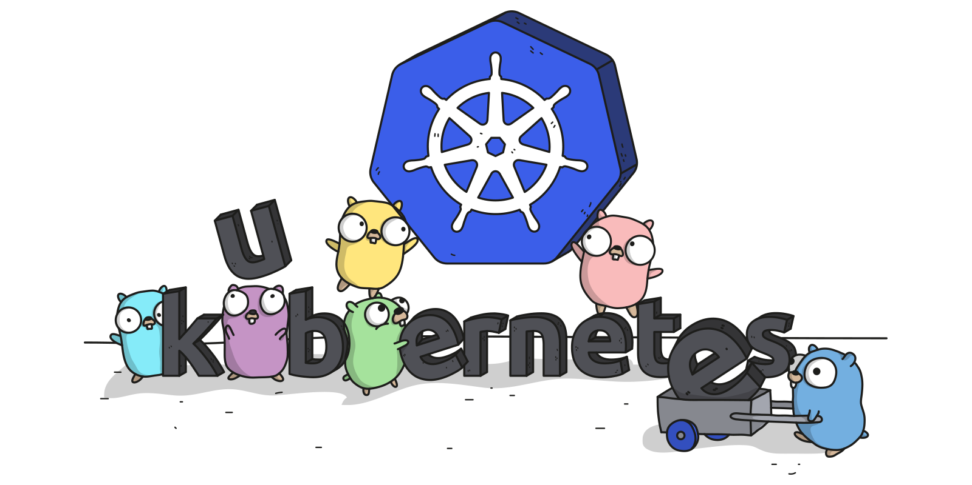
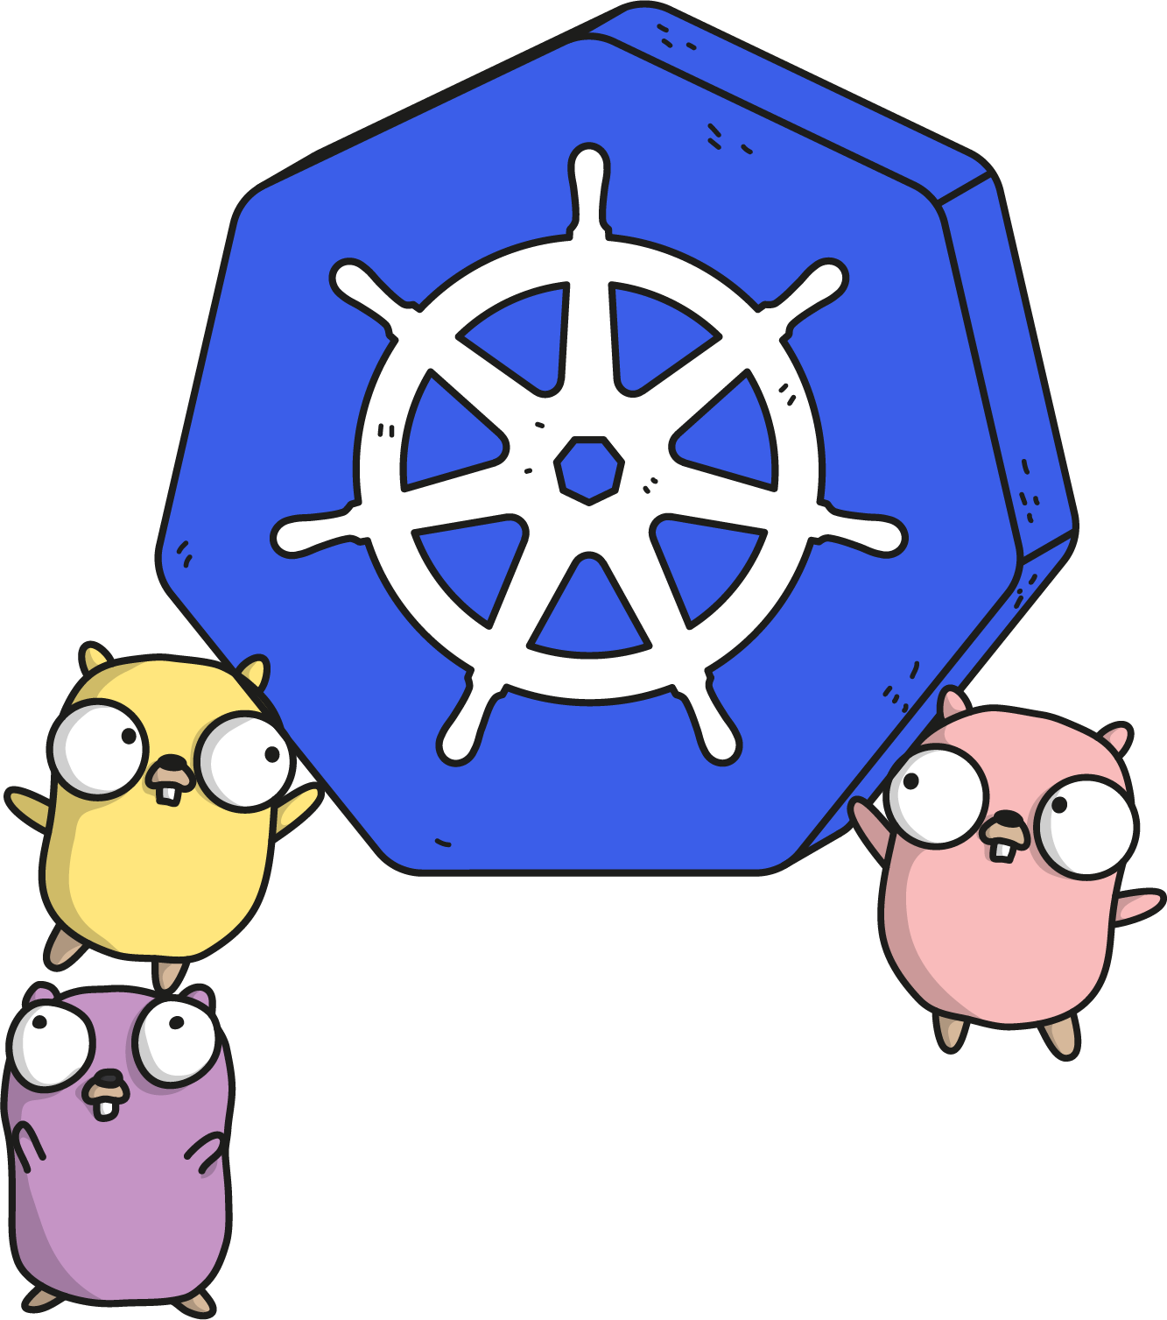
KUBERNETES 101

Slide 2
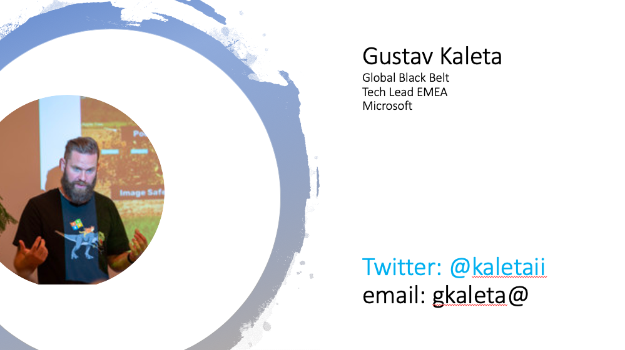

Gustav Kaleta Global Black Belt Tech Lead EMEA Microsoft Twitter: @kaletaii email: gkaleta@

Slide 3
Software and hardware refresh
Security threats
Urgent capacity needs
Compliance
Deliver innovation and new features quicker
Enable new business opportunities
Modernization triggers
Attract new talents
Datacenter contracts expiry or Software end of support
Notes:
Lead with this slide. Use it as a conversation starter with customer. Talk about an experience you have with one of these. Encourage customer to share their experiences with us. Do not cover every topic. Do allow customer to bring new topics.
What opportunities does customer see in Azure/cloud?
What challenges does customer have?
What specific opportunities and/or challenges is customer interested in pursuing?
What related opportunities and/or challenges has customer not expressed to us?

Slide 5
Kubernetes momentum
By 2022
75
>
%
of global organizations will be running containerized applications in production¹
¹Gartner.
Notes:
Full statistic sources
Gartner. “6 Best Practices for Creating a Container Platform Strategy.” April 23, 2019. https://www.gartner.com/smarterwithgartner/6-best-practices-for-creating-a-container-platform-strategy/

Slide 6
What’s behind the growth?
Kubernetes: the leading orchestrator shaping the future app development and management
It’s widely used
It’s vendor-neutral
It’s community-supported
Kubernetes is in production for global companies across industries¹
A variety of cloud providers offer robust Kubernetes support
There’s a huge community of active contributors supporting Kubernetes³
Capital One
eBay
SAP
Azure
AWS
24,000 contributors since 2016
1.1 million contributions since 2016
New York Times
Pokémon Go
Spotify
VMWare
Red Hat
¹Kubernetes.io. “Kubernetes User Case Studies.” ²CNCF. “Kubernetes Is First…” ³CNCF. Keynote address.
Notes:
Full statistic sources
Kubernetes.io. “Kubernetes User Case Studies.” https://kubernetes.io/case-studies/
CNCF. “Kubernetes Is First CNCF Project To Graduate.” March 6, 2018. https://www.cncf.io/blog/2018/03/06/kubernetes-first-cncf-project-graduate/
CNCF. Keynote address at KubeCon CloudNativeCon Barcelona. May 21, 2019. https://www.oicheryl.com/2019/05/21/266-million-keynote-at-kubecon-cloudnativecon-barcelona/

Slide 7
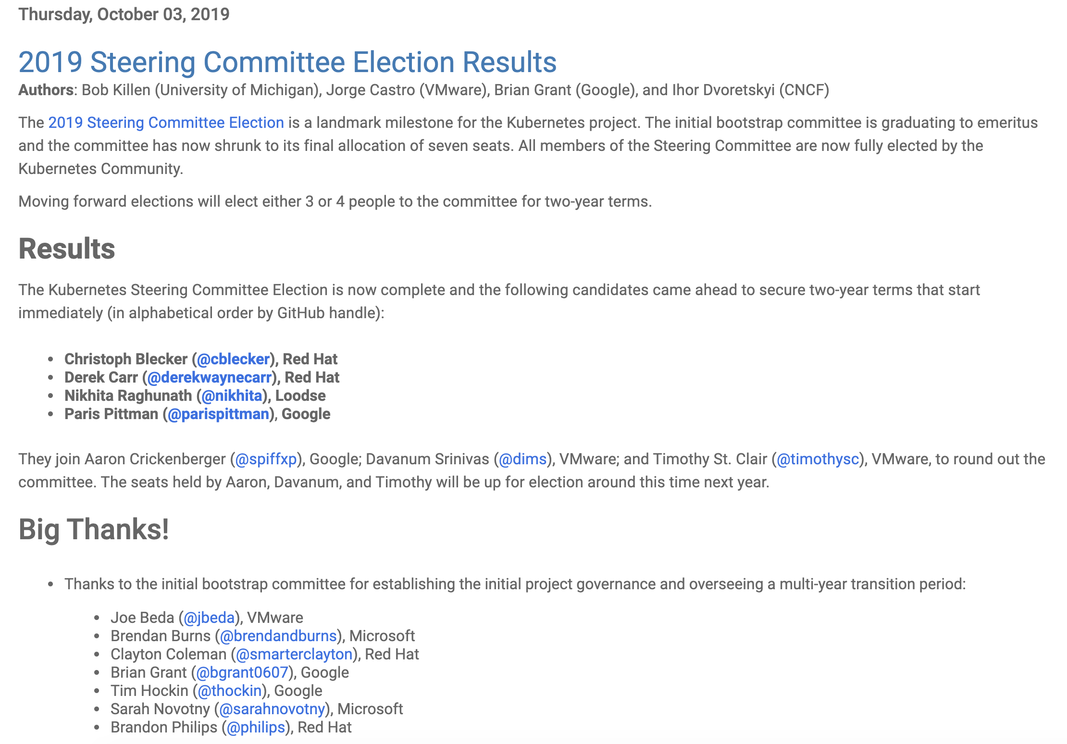
Notes:
https://kubernetes.io/blog/2019/10/03/2019-steering-committee-election-results/

Slide 8
How Kubernetes works
Kubernetes API
Your Application
Kubernetes control
Worker node
kubelet
kube-proxy
Internet
Kubernetes users communicate with API server and apply desired state
Master node
Docker
Pod
Pod
Master nodes actively enforce desired state on worker nodes
API server
Containers
Containers
Worker nodes support communication between containers
-controller-manager
-scheduler
Worker node
kubelet
kube-proxy
Internet
Worker nodes support communication from the Internet
replication, namespace, serviceaccounts, etc.
etcd
Docker
Pod
Pod
Containers
Containers

Slide 9
Kubernetes on Azure
Simplify the deployment, management, and operations of Kubernetes
Portable
Extensible
Self-healing
Manage and operate Kubernetes with ease
Accelerate containerized app development
Build on an enterprise-grade, secure platform
Run any workload anywhere
Notes:
Kubernetes is open-source orchestration software for deploying, managing, and scaling containers. It is highly portable, extensible and can self-heal.
The fully managed Azure Kubernetes Service (AKS) makes deploying and managing containerized applications easy. It offers serverless Kubernetes, an integrated continuous integration and continuous delivery (CI/CD) experience, and enterprise-grade security and governance. Combined with DevOps practices, AKS helps unite your development and operations teams on a single platform to rapidly build, deliver, and scale applications with confidence.
Running managed Kubernetes on Azure has the following benefits:
Manage K8s with ease: Minimize infrastructure maintenance leveraging managed control plane, automated upgrades and repair, and built-in monitoring. And achieve higher availability and protect applications from datacenter failures using redundancies across availability zones.
Accelerate containerized development: Faster end-to-end development experience and integration with Visual Studio Code, Azure Pipelines and Azure Monitor
Build on enterprise-grade secure foundation: Advanced identity and access management using Azure Active Directory, and dynamic rules enforcement across multiple clusters with Azure Policy.
Run any workload anywhere: From Windows to Linux containers, from public cloud to IoT Edge, use Kubernetes to orchestrate anything running anywhere

Slide 10
Manage Kubernetes with ease
Focus on your containers and code, not the plumbing of them
Responsibilities | DIY with Kubernetes | Managed Kubernetes on Azure
Containerization
Application iteration, debugging
CI/CD
Provisioning, upgrades, patches
Reliability availability
Scaling
Monitoring and logging
Azure managed control plane
App/ workload definition
Self-managed master node(s)
Kubernetes API endpoint
etcd Store
User
API server
Scheduler
Controller Manager
Cloud Controller
Schedule pods over private tunnel
Customer VMs
Docker
Docker
Docker
Docker
Docker
Pods
Pods
Pods
Pods
Pods
Customer
Microsoft
Notes:
A Kubernetes cluster is typically made up of
Master nodes for system components like the API server, etcd store, and scheduler
Agent nodes for user container workloads
Managing the cluster involves:
Monitoring the API server
Ensuring HA/DR for the etcd store
Safely managing upgrades across Kubernetes versions
Safely scaling the cluster in and out
Patching master and agent VM nodes
And on and on…
This is complex, error-prone, and expensive
A managed service like AKS moves those tasks to the cloud provider

Slide 11
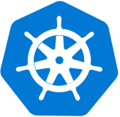

Kubernetes on its own is not enough
Save time from infrastructure management and roll out updates faster without compromising security
Development
Platform
Unlock the agility for containerized applications using:
Infrastructure automation that simplifies provisioning, patching, and upgrading
Tools for containerized app development and CI/CD workflows
Services that support security, governance, and identity and access management
IDE container support
Security
Governance
Identity
Source code repository
Kubernetes
Registry supporting
Helm
CI/CD
Infrastructure automation
Monitoring
Virtual machines
Networking
Microservice debugging
Storage
Data

Slide 12





Accelerate containerized development
Kubernetes and DevOps better together
Develop
Deliver
Operate
͏Develop
Native containers and Kubernetes support in IDE
Remote debugging and iteration for multi-containers
Effective code merge
Automatic containerization
Inner loop
Azure Container Registry
AKS production cluster
GitHub repos
Scale
Azure DevSpaces
AKS dev cluster
Test
Azure Monitor
͏Deliver
CI/CD pipeline with automated tasks in a few clicks
Pre-configured canary deployment strategy
In depth build and delivery process review and integration testing
Private registry with Helm support
Debug
Container image
Boards
CI/CD Pipelines
Helm chart
Terraform
͏Operate
Out-of-box control plane telemetry, log aggregation, and container health
Declarative resource management
Auto scaling

Slide 13
Kubernetes on Azure
Simplify the deployment, management, and operations of Kubernetes
Portable
Extensible
Self-healing
Manage and operate Kubernetes with ease
Accelerate containerized app development
Build on an enterprise-grade, secure platform
Run any workload anywhere
Notes:
Kubernetes is open-source orchestration software for deploying, managing, and scaling containers. It is highly portable, extensible and can self-heal.
The fully managed Azure Kubernetes Service (AKS) makes deploying and managing containerized applications easy. It offers serverless Kubernetes, an integrated continuous integration and continuous delivery (CI/CD) experience, and enterprise-grade security and governance. Combined with DevOps practices, AKS helps unite your development and operations teams on a single platform to rapidly build, deliver, and scale applications with confidence.
Running managed Kubernetes on Azure has the following benefits:
Manage K8s with ease: Minimize infrastructure maintenance leveraging managed control plane, automated upgrades and repair, and built-in monitoring. And achieve higher availability and protect applications from datacenter failures using redundancies across availability zones.
Accelerate containerized development: Faster end-to-end development experience and integration with Visual Studio Code, Azure Pipelines and Azure Monitor
Build on enterprise-grade secure foundation: Advanced identity and access management using Azure Active Directory, and dynamic rules enforcement across multiple clusters with Azure Policy.
Run any workload anywhere: From Windows to Linux containers, from public cloud to IoT Edge, use Kubernetes to orchestrate anything running anywhere

Slide 14

Turn this into K8s Best Practices
Join Skype Meeting

Slide 15
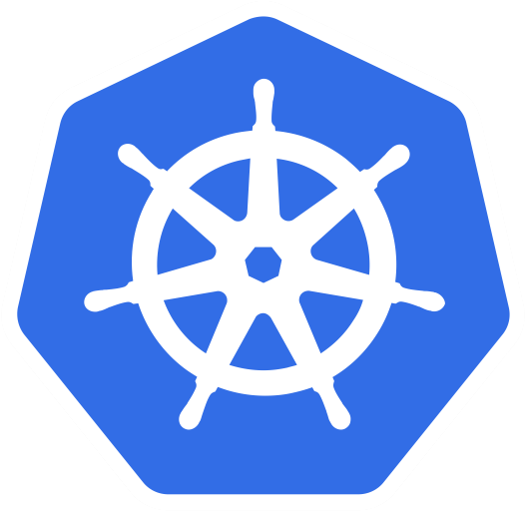
Cluster Isolation Patterns: Physical Isolation
Dev Cluster
Staging Cluster
Node0
Node1
Node0
Node1
PodA
PodB
PodE
PodF
PodA
PodB
PodE
PodF
PodC
PodD
PodG
PodH
PodC
PodD
PodG
PodH
Prod Team1 Cluster
Prod Team2 Cluster
Node0
Node1
Node0
Node1
PodA
PodB
PodE
PodF
PodA
PodB
PodE
PodF
PodC
PodD
PodG
PodH
PodC
PodD
PodG
PodH

Slide 16
Cluster Isolation Patterns: Logical Isolation
Dev and Staging Cluster
Prod Cluster
Node0
Node1
Node0
Node1
DevTeam1
Team1
Pod
Pod
Pod
Pod
Pod
Pod
Pod
Pod
Pod
Pod
Pod
Pod
Staging
Pod
Pod
Pod
Pod
Team2
Node2
Node3
Node3
Node4
Pod
Pod
Pod
Pod
Pod
Pod
Pod
Pod
Pod
Pod
Pod
Pod
DevTeam2
Pod
Pod
Pod
Pod
Team3

Slide 17
Isolation Dimensions
Resource Quotas.
Node Selectors , Taints and Tolerations.
Node Affinity, Pod Affinity and Anti-Affinity
Pod Budget Policies …
Scheduling
Authentication and Authorization
RBAC with AAD.
Pod Identity.
Secrets with Keyvault. ….
Network Policies
Networking
Containers
Scan images and runtime
Leverage Linux Capabilities
Pod security policy
Pod security context ….

Slide 18
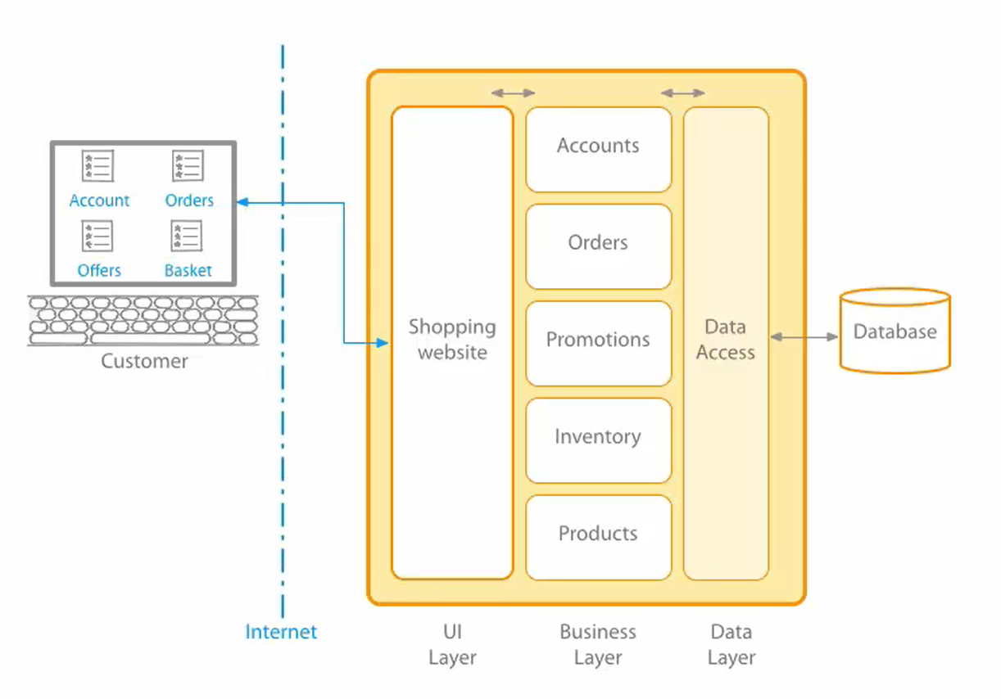
A Monolith?

Slide 19
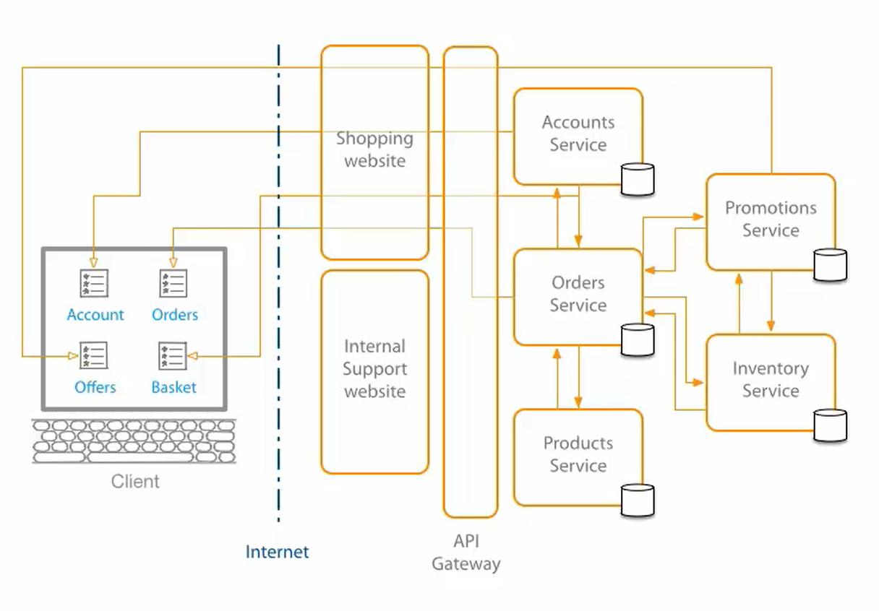
Microservices…

Slide 20
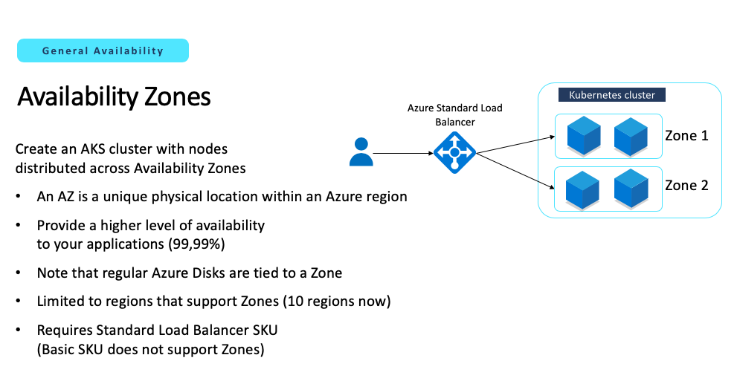

Slide 21
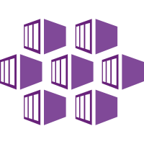
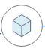


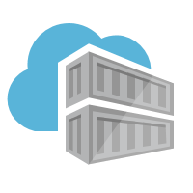
Our Application – with AZs
Region 1
app namespace
AZ1
Node1
AZ2
Client App
Standard Loadbalancer
region1-acr
Node2
AZ3
Node3
Backend App
Mysql Database
Notes:
- How the application will look like

Slide 22
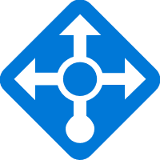
'AZ AKS CREATE’ | App Before
AKS subnet
Azure Files
Web Pod(s)
Worker Pod(s)
External
Load Balancer

Slide 23
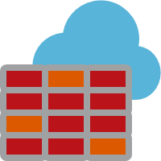

App After
Secure Registry
via Service Endpoints
(Coming Soon)
Reduce Secrets Mgmt
via AAD Pod Identity
API server
Azure Container Registry
Azure Firewall Subnet
App Gateway Subnet
AKS subnet
Web Pod(s)
Worker Pod(s)
Azure Files
Service Endpoint
Internal Load Balancer
Secure File Share Access
via Service Endpoints
Control Outbound Traffic
via Azure Firewall
Adding WAF & Ingress
via App Gateway
No Public IP via
Internal LB
Network Segmentation
via Network Policy

Slide 24
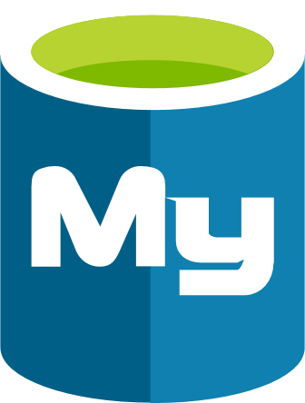

Multiple Clusters - Same Region
Region 1
Cluster1
app namespace
Master
Azure Load Balancer
Backend App
region1-acr
Read Replica1
Client Browser
Cluster2
app namespace
Azure Load Balancer
Read Replica 2
Backend App
Notes:
Protection from human errors only
State externalized

Slide 25
Multiple Clusters - Cross Region – One Master - Hot
Azure Region1
app namespace
R1-ACR
Read/Write
Master
Standard Loadbalancer
Geo Replication
Active
Backend App
Read Replica1
Client Browser
Traffic Manager
Azure Region2
Active
app namespace
R2-ACR
Read
Standard Loadbalancer
Read Replica 2
Backend App
Notes:
ACID, relational data bases, only reads
ACR, geo-replication or deploy twice

Slide 26
Multiple Clusters - Cross Region – Cold/Scaled Down
Azure Region1
app namespace
R1-ACR
Read/Write
Master
Standard Loadbalancer
Geo Replication
Active
Backend App
Read Replica1
Client Browser
Traffic Manager
Azure Region2
Cold \ Scaled Down
Active
app namespace
R2-ACR
Read
Standard Loadbalancer
Read Replica 2
Backend App
Notes:
- Less cost, lower RTO

Slide 27
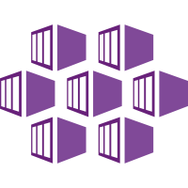




Multiple Clusters - Cross Region – Multiple Masters
Azure Region 1
app namespace
Multi—Master Cosmos
R1-ACR
Read/Write
Standard LoadBalancer
Active
Read/Write
Backend App
Azure Region 2
Client Browser
Traffic Manager
app namespace
Active
R2-ACR
Read/Write
Standard LoadBalancer
Read/Write
Backend App
Notes:
- Active active, demo!

Slide 28
NodePool considerations
AKS API operations will be decoupled for control plane and node pools.
Most operations are now at node pool level (scale, upgrade,…)
You can add taints to the node pool profile that will automatically add them to every new node
Cluster AutoScaler works on a per node pool basis
An AKS cluster can have a maximum of 8 node pools
An AKS cluster can have a maximum of 400 nodes across those node pools
You can leverage the Public IP per Node feature in selected node pools
Notes:
- Excited about the decoupling

Slide 29
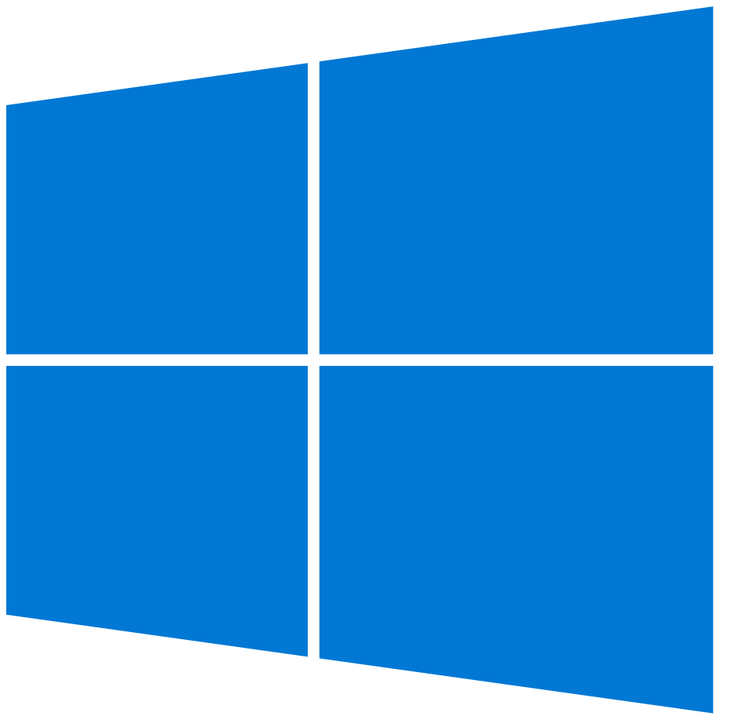

Manage Kubernetes with ease
Windows Server Containers
Azure managed control plane
App/ workload definition
Self-managed master node(s)
With multiple node pool capabilities, you can now mix Windows and Linux VMs in your AKS clusters
Can schedule mixed-os workloads, using nodeSelector
Kubernetes API endpoint
etcd Store
User
API server
Scheduler
Controller Manager
Cloud Controller
Schedule pods over private tunnel
Schedule pods over private tunnel
Customer VMs – Nodepool 2
Customer VMs – Nodepool 1
VM
VM
VM
VM
Docker
Docker
Docker
Docker
Docker
Docker
Docker
Docker
Pods
Pods
Pods
Pods
Pods
Pods
Pods
Pods
kubelet
kube-proxy
kubelet
kube-proxy
kubelet
kube-proxy
kubelet
kube-proxy
Notes:
Substitute for 14

Slide 30
Kubernetes Versions
X.Y.Z i.e. 1.14.0
AKS Supports N-2 Latest Supported Version is 1.10.X
AKS supports 2 patch versions at any given minor release
1.14.0
Major No Current Plans for v 2.0.0
Minor Every ~ 3 month
New Features and APIs
Maintained for the 3 minor release branches
Minor release branch is maintained for ~9months
Patch Keeps Ticking / Week(s) Critical Bug Fixes to the Latest Minor Release
Notes:
https://github.com/kubernetes/community/blob/master/contributors/design-proposals/release/versioning.md#kubernetes-release-versioning

Slide 31
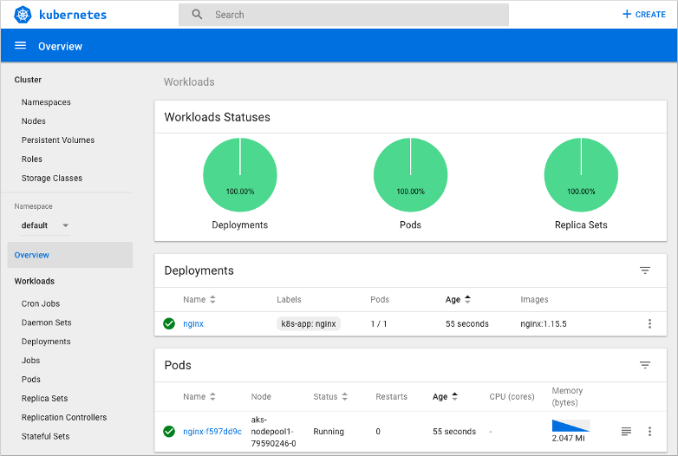
Kubernetes Dashboard

Slide 32
Disable the Dashboard (Recommended)
$ kubectl get pods -n kube-system | grep "dashboard"
kubernetes-dashboard-cc4cc9f58-whmhv 1/1 Running 0 30d
$ az aks disable-addons -a kube-dashboard -g k8s-demo -n k8s-demo-rbac
$ kubectl get pods -n kube-system | grep "dashboard"

Slide 33
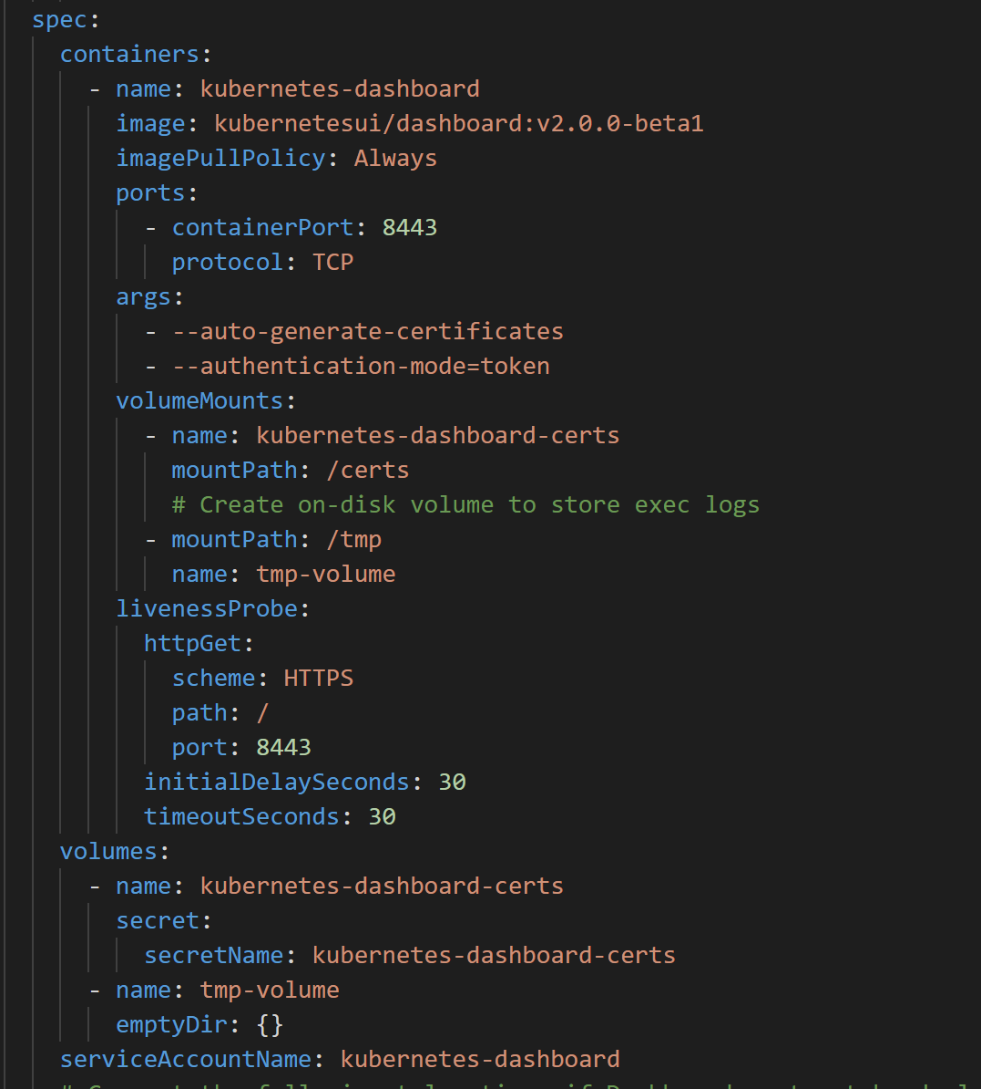
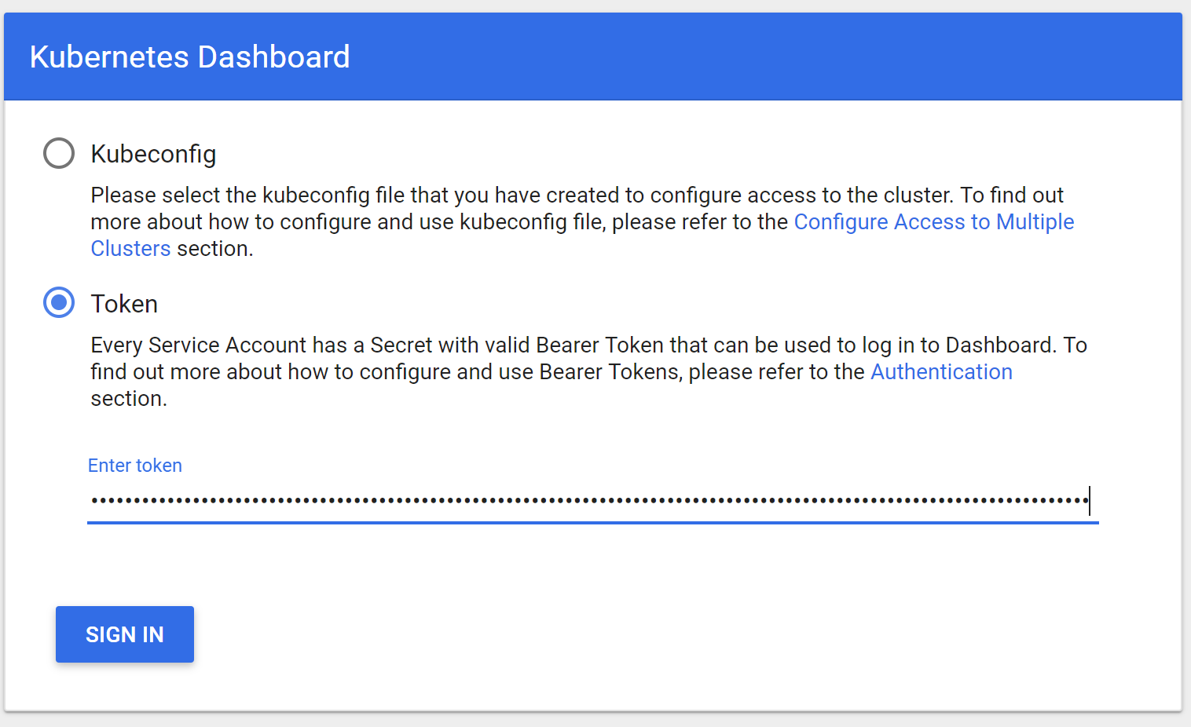
Kubernetes Dashboard – less worse

Slide 34
Advanced networking
Node1
Node2
Uses the Azure CNI (Container Networking Interface)
CNI is a vendor-neutral protocol, used by container runtimes to make requests to Networking Providers
Azure CNI is an implementation which allows you to integrate Kubernetes with your VNET
Advantages
Single IP CIDR to manage
Better Performance
Peering and On-Premise connectivity is out of the box
Pod
Pod
Pod
Pod
Pod
Pod
Azure CNI
Azure CNI
Bridge
Bridge
Customer Managed Azure VNet
172.19.0.0/16

Slide 35

Networking
Secure your Kubernetes workloads with virtual network and policy-driven communication paths between resources
Kubernetes cluster: Azure VNET
Internal Load Balancer
Egress lockdown
External DNS
Control plane
Ingress Controller
App Gateway
Private cluster
Worker node
Worker node
kubelet
Pods
Pods
kubelet
Containers
Containers
Namespace

Slide 36

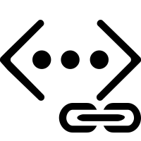
Scenarios enabled by Advanced Networking
Uses Azure subnet for both your containers and cluster VMs
1
On-premises infrastructure
3
Azure VNet A
Enterprise system
Allows for connectivity to existing Azure services in the same VNet
Backend services subnet
AKS subnet
Azure Express Route
AKS cluster
SQL Server
Use Express Route to connect to on-premises infrastructure
Azure SQL PaaS DB
5
Use VNet peering to connect to other VNets
2
Service Endpoint
Connect AKS cluster securely and privately to other Azure resources using VNet endpoints
VNet peering
Other peered VNets
4
AKS VNet integration works seamlessly with your existing network infrastructure

Slide 37
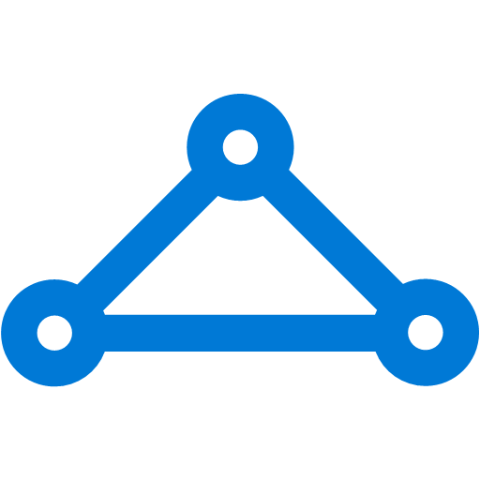
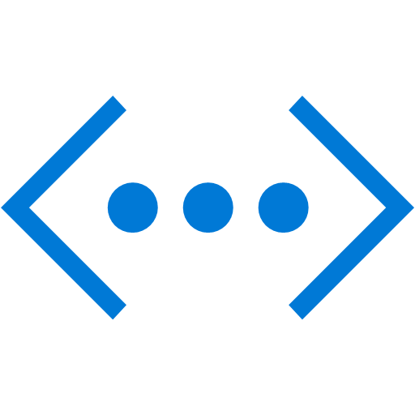
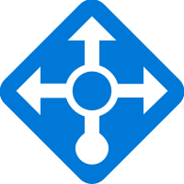

Internal Service
VNet B
On-premises infrastructure
Other peered VNets
Enterprise system
Used for internal services that should be accessed by other VNETs or On-Premise only
VNet peering
Azure Express Route
apiVersion: v1
kind: Service
metadata:
name: internalservice
annotations:
service.beta.kubernetes.io/azure-load-balancer-internal: "true"
spec:
type: LoadBalancer loadBalancerIP: 10.240.0.25
ports:
- port: 80
selector:
app: internal
Azure AKS VNet
Internal IP
Internal LB
AKS subnet
AKS cluster
InternalService
Pod1 label:Internal
Pod2 label:Internal
Pod3 label:Internal

Slide 38

Identity
Use familiar tools like AAD for fine-grained identity and access control to Kubernetes resources from cluster to containers
Storage
AKS with RBAC
Active Directory
VNet
Active Directory
SQL Database
Node
Node
Synced identity
Pod
Pod
AAD Pod Identity
Cosmos DB
Key Vault

Slide 39

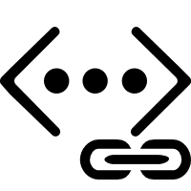
Secure network communications with VNET and CNI
Uses Azure subnet for both your containers and cluster VMs
1
On-premises infrastructure
3
Azure VNet A
Enterprise system
Allows for connectivity to existing Azure services in the same VNet
Backend services subnet
AKS subnet
Azure Express Route
AKS cluster
SQL Server
Use Express Route to connect to on-premises infrastructure
Azure SQL PaaS DB
5
Use VNet peering to connect to other VNets
2
Service Endpoint
Connect AKS cluster securely and privately to other Azure resources using VNet endpoints
VNet peering
Other peered VNets
4
AKS VNet integration works seamlessly with your existing network infrastructure

Slide 40
Azure Pipelines build audit & enforcement using Azure Policy
Cloud architect assigns a policy across clusters; policy can be set to block non-compliance (deny) or generate non-compliance warnings (audit)
Cloud Architect
Azure Policy
1
Developer makes code change that kicks off an Azure Pipelines build
Azure Pipelines evaluates the request for policy compliance
Azure Pipelines
4
Yes
Deny policy
No
If policy is set to deny, Azure Pipelines rejects the build attempt if any non-compliance is identified
Developer
Fail
5
Compliance check
AKS
2
3
If policy is set to audit, a non-compliance event is logged and the build is allowed to proceed
Cluster-1
Cluster-2
Cluster-3
Pass

Slide 41
How HPA works?
Node1
Horizontal Pod Autoscaler
Deployment
ReplicaSet
Pod
replicas++
Kublet
replicas--
cAdvisor
Pod
Gets metrics from
NodeX
Collects metrics from all nodes
Node2
Metrics Server
Pod
Kublet
Collects metrics from all containers on the node
cAdvisor

Slide 42

Cluster Autoscaler
Scales nodes based on pending pods
Scale up and scale down
Reduces dependency on monitoring*
Removes need for users to manage nodes and monitor service usage manually
Additional node(s) needed
CA
Pods are in pending state
Pod
Pod
Node is granted
Pending pods are scheduled
Node
Node
Pod
Pod
Pod
Pod
AKS Cluster

Slide 43
Q/A

Slide 44
Gustav Kaleta Global Black Belt Tech Lead EMEA Microsoft Twitter: @kaletaii email: gkaleta@

Slide 45
AKS + K8s + Containers Best Practices
Goto these links below first, for the latest best practices.
This guide supplements and adds in additional best practice guidance.
https://aka.ms/aks/best-practices-sessions Operational best practices for Azure Kubernetes Service
https://github.com/Azure/aks-bestpractices-ignite19
https://www.youtube.com/watch?v=RJJ4CUyja6M
https://docs.microsoft.com/en-us/azure/aks/faq
https://docs.microsoft.com/en-us/azure/aks/best-practices
https://github.com/Azure/k8s-best-practices
https://docs.microsoft.com/en-us/azure/aks/operator-best-practices-cluster-security
https://docs.microsoft.com/en-us/azure/aks/troubleshooting
https://docs.microsoft.com/en-us/azure/container-registry/container-registry-best-practices

Slide 46
AKS + K8s + Containers Best Practices
Best practices for cluster isolation in AKS
https://docs.microsoft.com/azure/aks/operator-best-practices-cluster-isolation
Best practices for business continuity and disaster recovery in Azure Kubernetes Service (AKS)
https://docs.microsoft.com/en-us/azure/aks/operator-best-practices-multi-region
Best practices for authentication and authorization in AKS
https://docs.microsoft.com/azure/aks/operator-best-practices-identity
Best practices for pod security in AKS
https://docs.microsoft.com/azure/aks/developer-best-practices-pod-security

Slide 47
AKS + K8s + Containers Best Practices
Best practices for business continuity and disaster recovery in AKS
https://docs.microsoft.com/azure/aks/operator-best-practices-multi-region
Best practices for container image management and security in AKS
https://docs.microsoft.com/azure/aks/operator-best-practices-container-image-management
Best practices for network connectivity and security in AKS
https://docs.microsoft.com/azure/aks/operator-best-practices-network

Slide 48
AKS + K8s + Containers Best Practices
Best practices for advanced scheduler features in AKS
https://docs.microsoft.com/azure/aks/operator-best-practices-advanced-scheduler
Best practices for storage and backups in AKS
https://docs.microsoft.com/en-us/azure/aks/operator-best-practices-storage
AKS Solution Booklet - Learn about Kubernetes benefits, challenges, and enhancements made possible by a managed platform. Get the most out of Azure Kubernetes Service (AKS) with top scenarios, Azure capabilities, and tools
https://azure.microsoft.com/en-us/resources/kubernetes-on-azure-solution-booklet/

Slide 49
AKS + K8s + Containers Best Practices
Books…
Notes:
Kubernetes Patterns (free) - Reusable Elements for Designing Cloud-Native Applications - 266 page O'Reilly Book
https://www.redhat.com/cms/managed-files/cm-oreilly-kubernetes-patterns-ebook-f19824-201910-en.pdf

Slide 50
Container Best Practises
Remember that containers are designed to be ephemeral | Avoid including unnecessary packages within your container image
Use .dockerignore file Reduce build context size node_modules, npm-debug.log | Use multi-stage builds Compile code and then package
Start with an appropriate image Openjdk vs ubuntu image | Tag container images extensively V1, v2, v3 etc..
Dockerfile Best Practises https://blog.docker.com/2019/07/intro-guide-to-dockerfile-best-practices

Slide 51
Azure Security Center
Continuous discovery of managed AKS instances
Actionable reccomendations on security best practices for AKS
Host and Cluster based threat detection analysis
Azure ARC
Access unique Azure security capabilities such as Azure Threat Detection
Centrally manage access and security policies for resources with Role Based Access Control
Enforce compliance and simplify audit reporting

